Slide 1
Medical Careers Tutorial Pathway Stella Coleman

Slide 2
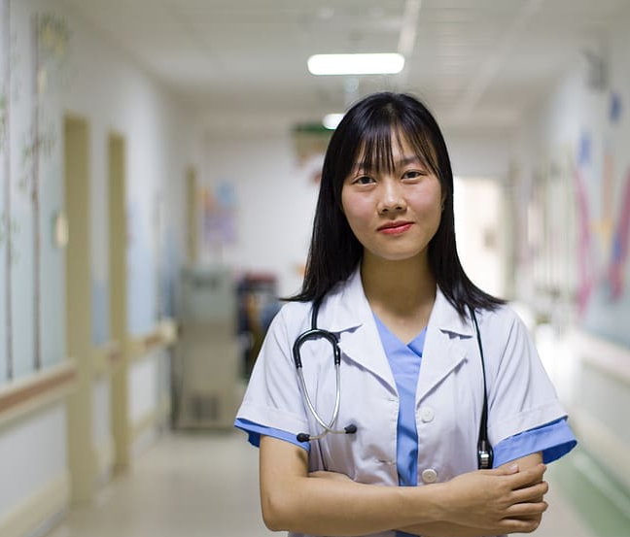
Overview
Why a Medical Careers Tutorial Pathway?
How does it work?
Timeline for applications
What do universities look for?
Widening participation
Useful links
Q & A

Slide 3
Why a Medical Careers Tutorial Pathway?

Slide 4
Why a Medical Careers Tutorial Pathway?
No of applicants this year for Medicine: (Medic Portal)
26,820 (up 29% since 2017) 5,010 reapplying (up 50% since 2017)
No of offers this year:
Medicine and dentistry 16% nationally (UCAS) 39% BHASVIC
Veterinary 50% nationally (Vet schools council) 60% BHASVIC
No of places available for 2024 (Office for students & Vet schools council)
7,115 Medicine (down 32% since 2021)
766 Dentistry
1200 Veterinary (approx)
24 times more likely to become a doctor than your peers if your parent is
a doctor (Friedman, S and Laurison, D (2016) The Class Ceiling: Why it
pays to be Privileged)

Slide 5
How does it work?

Slide 6
How does it work?
Tutor groups for students applying for Medicine, Dentistry and Veterinary courses (early application deadlines Oct 16th 2023)
45 min group tutorial once a week, with 1-2-1 support alongside
Tailored content to support with key milestones in the applications process, like admissions tests and interviews
Enrichment activities (Medsoc sessions weekly)

Slide 7
The standard UCAS pathway is better for:
Allied health professions e.g. nursing, physiotherapy, optometry etc with standard application deadlines (Jan 2024)
Those wanting to apply in 2024, after their results

Slide 8
We provide help and support
Our students need to take the lead in:
Researching their courses
Checking eligibility criteria and entry requirements
Finding work experience
Writing personal statements
Completing admissions paperwork on time
Preparing for admissions tests and interviews

Slide 9
Timeline for applications

Slide 10
The Summer Term
Progression week (22nd to 26th May 2023):
Early UCAS application talk on 22nd May
Trip to BSMS on 25th May
Medical tutor groups start after half term
Tutorial:
Course choices and eligibility criteria
Admissions tests
First draft of personal statement
Begin application process on UCAS Apply
Students should be making full use of the enrichment opportunities on Medsoc
All Medicine and Dentistry students sit the UCAT
admissions test in the summer holidays

Slide 11
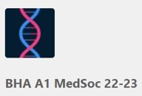
Medsoc enrichment
Lots of free opportunities
posted in channels
Drop in sessions every
Thursday in room 24
at 11.50

Slide 12
The Autumn Term
September - before the start of term:
Final draft of personal statement
September onwards:
Apply by BHASVIC internal UCAS deadline
22nd Sept 2023
(UCAS external deadline 16th Oct 2023)
18th Oct 2023 BMAT sat at BHASVIC
(50% BHASVIC students)
Tutorial:​
Finalising applications​
Understanding the interview process
Interviews take place Nov to April
Offers up to May

Slide 13
What do universities look for?

Slide 14
What do universities look for?
Applications are screened out (invited to interview) using:
Entry requirements
GCSE grades – typically 6 or above in Maths/English
Predicted A-level grades – typically AAA or above
Admissions test scores UCAT/BMAT
Evidence of suitability​
Understanding the profession
Skills

Slide 15
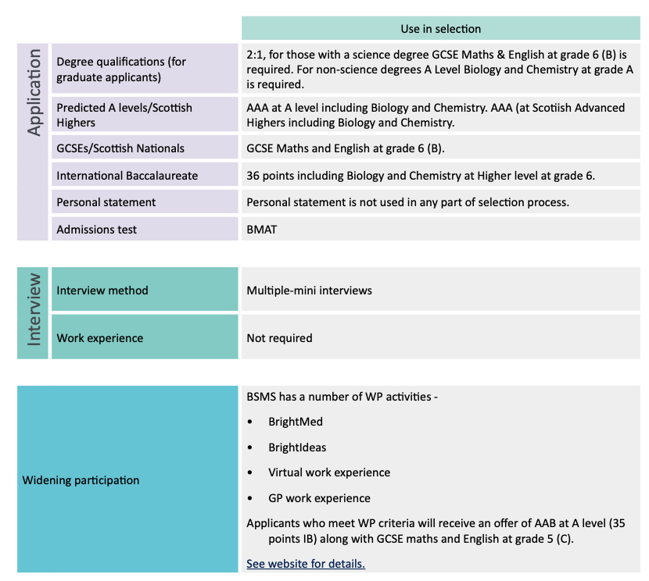
Brighton and Sussex Medical School (Medicine A100) 5 years
Medicine 2023 Entry
Requirements
https://www.medschools.ac.uk/news/2023-entry-requirements-for-uk-medical-schools-published (web based)
https://www.medschools.ac.uk/media/2951/entry-requirements-document-2023-entry.pdf (pdf)
NOTE Entry requirements are updated in June. Recheck the information in the summer before applying.

Slide 16
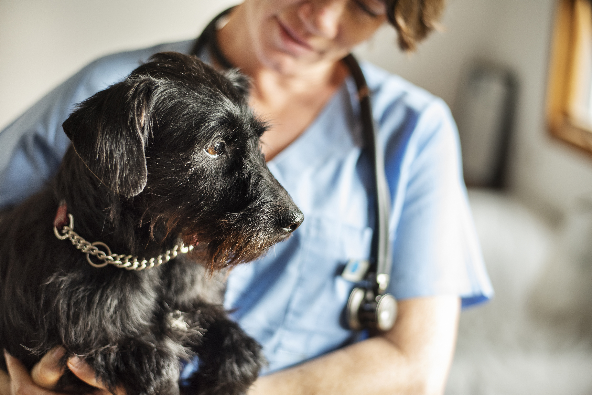
NOTE Entry requirements are updated in June. Recheck the information in the
Summer before applying
Dentistry
2023 Entry
Requirement
https://www.dentalschoolscouncil.ac.uk/wp-content/uploads/2022/07/DSC-Entry-Requirements-2023-1.pdf
Vetinerary
2023 Entry
Requirement
https://www.vetschoolscouncil.ac.uk/news/2023-entry-requirements-for-uk-veterinary-schools-published/

Slide 17
Admissions tests UCAT
Used by most Medical and Dental schools
Taken privately during the Summer (at a driving test centre)
Range of dates available (10th July 2023 to 28th Sept 2023)
Bursaries available
Register from 16th May 2023, bookings open 20th June 2023
Website: https://www.ucat.ac.uk/
BHASVIC strongly recommends sitting the UCAT before September

Slide 18
Admissions tests BMAT
Used by a small number of Dental and
Medical Schools including Cambridge,
Oxford, BSMS
Taken at BHASVIC
(one sitting 18th October 2023)
Website: https://www.admissionstesting.org/for-test-takers/bmat/

Slide 19
Admissions tests: NSAA
Natural Sciences Admissions Assessment
(NSAA)
Only used by Cambridge Veterinary School
Taken at BHASVIC
(one sitting 18th October 2023)
Website https://www.admissionstesting.org/for-test-takers/cambridge-pre-registration-assessments/

Slide 20
Suitability: Understanding the profession
We asked our second years what was the ONE toughest interview question they faced this year:
What is the impact of social housing on both physical and mental health?
What would the world be like if there was no electricity?
What would you find difficult about working within a diverse community?
How can you combat the food shortage without meat while maintaining enough protein in your diet?
Discuss personalised medicine
Students should immerse
themselves in:
Talks and lectures
Q & A sessions with students and professionals
Documentaries
Wider reading, current affairs
Work experience/shadowing – in person or online

Slide 21
Suitability: Skills
Students need to demonstrate they have the necessary skills needed for the profession:​
Communication
Empathy
Teamwork
The ability to manage competing priorities
Organisation
Leadership
More interview questions from the second years
​
What is your biggest weakness?
Can you tell us what respect and dignity means to you? ​
Tell me about a time when you showed resilience
Tell me about a time when you managed a stressful deadline
Demonstrated through:
Work experience
Volunteering
Paid work
Extra-curricular activities
Other responsibilities
​

Slide 22
Work Experience Medicine/Dentistry
Do I need to have work experience in a hospital or dentist?
No. The important thing is to build up a portfolio of experiences to demonstrate your understanding of the profession and relevant skills
Vaccination clinic
Care home
Hospice
Disabled children's swimming school
Charity shop
BSMS online work experience
Young carer
Our second years found work experience:

Slide 23
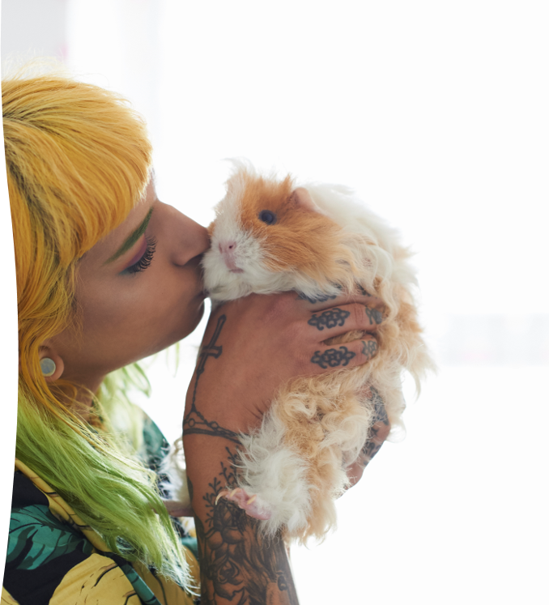
Work Experience: Veterinary
Veterinary courses may have strict minimum
requirements for work experience (BOTH veterinary
practice and animal WE) and ask for extra
questionnaires when applying
Equine hospital
Farm: lambing, dairy
Reptile RSPCA in Brighton
Garden centre
Guinea pig rescue centre
Zoo
Horse riding school
Online work experience
Our second year vets found work experience in:

Slide 24
Free online work experience
Medicine
BSMS https://bsmsoutreach.thinkific.com/courses/VWE
Observe GP
https://www.rcgp.org.uk/training-exams/discover-general-
practice/observe-gp.aspx
Dentistry
Sheffield Uni (by 4th June)
https://www.futurelearn.com/courses/discover-dentistry
Veterinary
Sheffield Uni (by 7th May)
https://www.futurelearn.com/courses/vet-school-application-support

Slide 25
Widening participation

Slide 26
Widening Participation Students (WP)
Most commonly used criteria:
Low family income
Living in an area of deprivation or
low rates of university attendance
Low performing GCSE school
Care experienced
Less commonly used criteria:​
Young carer​
Ethnicity​
Disability/long term health issues
First in family to go to uni​
Refugee/asylum seeker
Universities may offer WP students one or more of the following:
Lower offers – typically 1 grade lower​
Reserved places at interview​
Additional courses/summer schools to help you prepare for Uni​
​ Gateway courses​ (extra preparation year open to students meeting a number
of WP criteria - often a BBB offer)

Slide 27
Widening Participation – do I have to do anything?
Most widening participation criteria are picked up automatically as part of the application process.
There are some schemes that you apply to separately (Info in the WP newsletter)
Exeter Scholars (apply in summer term)
Newcastle Partners (apply in Sept)
Access to Leeds (apply in Sept)
In2Surrey (apply when you've submitted your UCAS)

Slide 28
Useful links

Slide 29
Links for Medicine
It is not necessary to spend thousands of pounds on extra courses to get into medical school! ​
There is a wealth of FREE support, information and events run by universities, particularly for widening participation students​
Medical Schools Council https://www.medschools.ac.uk/studying-medicine​
The Medic Portal https://www.themedicportal.com​
BSMS Events Page​ https://www.bsms.ac.uk/about/events/index.aspx

Slide 30
Links for Dentistry
The Medic Portal
https://www.themedicportal.com/application-guide/dentistry/
The Dental Schools Council:
https://studyinghealthcare.ac.uk/applications/dentistry/why-dentistry/
https://www.dentalschoolscouncil.ac.uk/making-an-application/work-experience/
Links for Veterinary
British Veterinary Association
https://www.bva.co.uk/media/4505/bva-guide-to-applying-to-study-veterinary-medicine.pdf
Vet Schools Council​
https://www.vetschoolscouncil.ac.uk/applications/work-experience/

Slide 31
Key dates 2023
Here are the key dates for a medical school application:
16th May 2023: UCAT registration opens
20th June 2023: UCAT test booking opens (book your own date between 10th July and 28th Sept. We recommend you sit your test before the start of term in September)
10th July 2023: UCAT testing begins
Two compulsory Personal Statement days in September – details to be provided later
1st September 2023: BMAT/NSAA registration opens
22nd September: completion of all Medics UCAS applications. You need to have a UCAT score by this date to make sure that you are qualified for your chosen university courses.
1st October: deadline for Medicine applicants to have been registered to take the BMAT
16th October: deadline for Medics UCAS applications (remember you can add your other university choices after this date until 31st January)
16th October deadline for applications for the Graduate Course in Medicine (applicants must complete and submit the Graduate Course in Medicine application form in addition to their UCAS application)
18th October: BMAT/NSAA tests sat at BHASVIC
November 2023-May 2024: Interviews take place throughout this period; you should anticipate that the experience can be very protracted.
24th November 2023: BMAT results released.
31st January 2024: UCAS Deadline for non-medical course choices
January-May: Offer outcomes

Slide 32
Please get in touch if you have further queries s.coleman@bhasvic.ac.uk
Q&A

