Slide 1
A2 UCAS Starting your UCAS form
Week 1

Slide 2
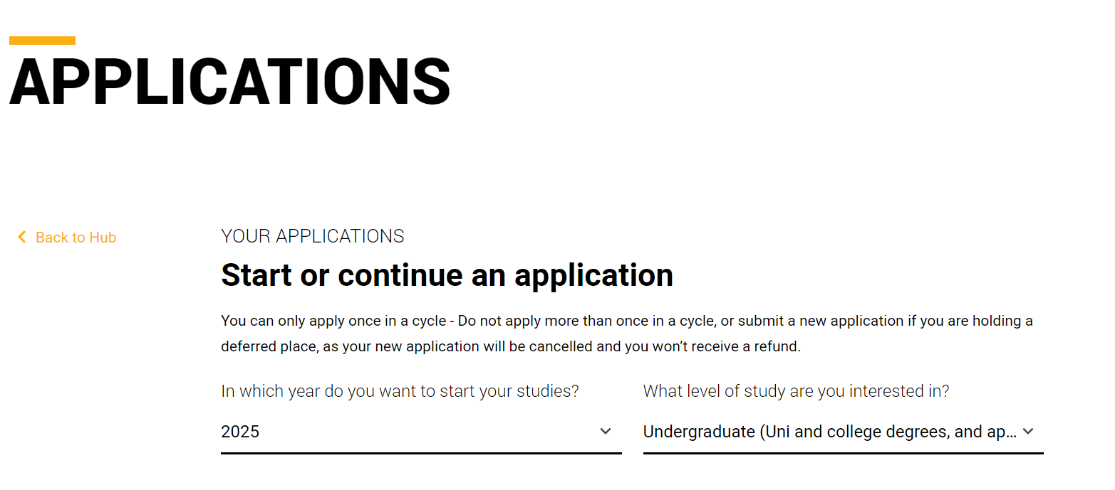
What’s this session about?
Register for the UCAS Hub (if you haven’t done so already
Use your PERSONAL EMAIL ADDRESS (NOT BHASVIC)
Starting your UCAS form
Completing some of the parts that are easy to get wrong!

Slide 3
The UCAS Hub
First steps first…register
Already registered? Log in

Slide 4
Your UCAS Application
If you are DEFINITELY taking a gap year and not intending to apply this year then register for the UCAS Hub and take a look around
If you are considering applying this year, or have definitely decided to do so, then register and start completing the application

Slide 5
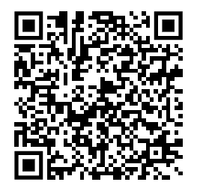
Helpsheet Resources
You will find all the info you need on the Welcome to the UCAS Pathway Sharepoint page along with lots of other UCAS resources.

Slide 6
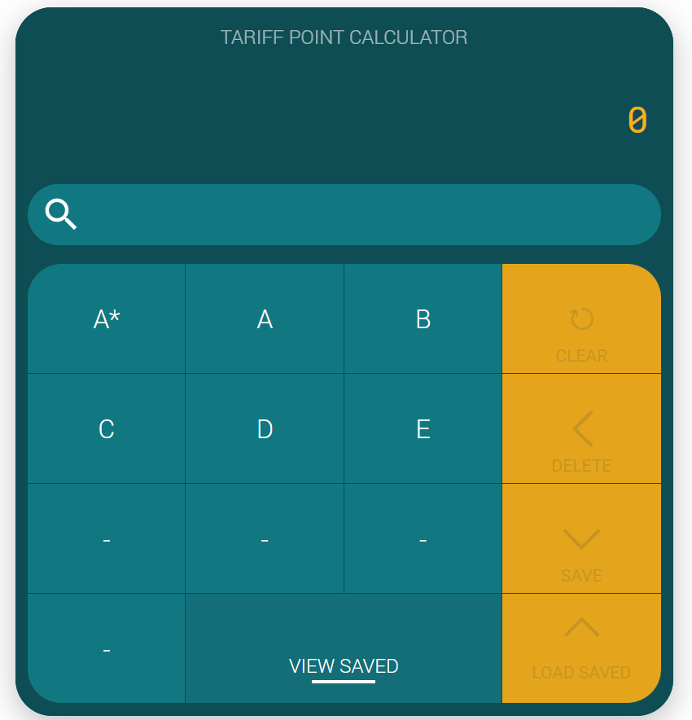
Explore the Widgets:
You know your predicted grades.
Try the UCAS tariff point calculator

Slide 7
Your application form
Definitely applying?
If you haven’t started an application yet – start one.
Make sure it is for 2025 (even if you are deferring).
Applications and Clearing will still be open for 2024 for a while.

Slide 8
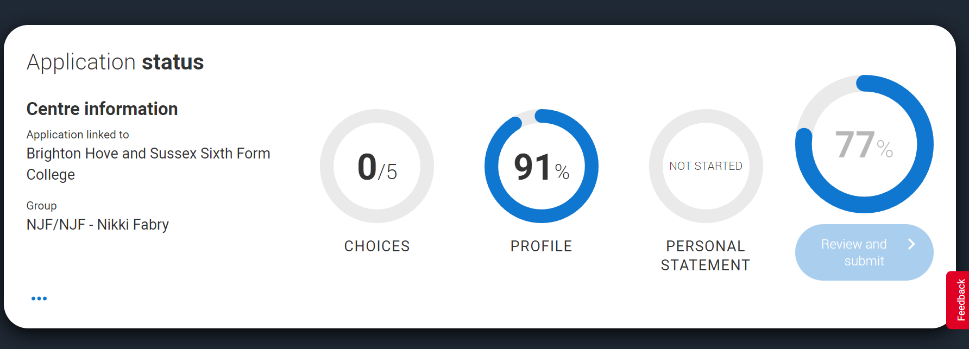
Dashboard
If you change tutor group at anytime tell us we can change it
It is linked to BHASVIC which means we can see it on our portal.
Choices and your personal statement are likely to be one of the last things you will add before it is processed.

Slide 9
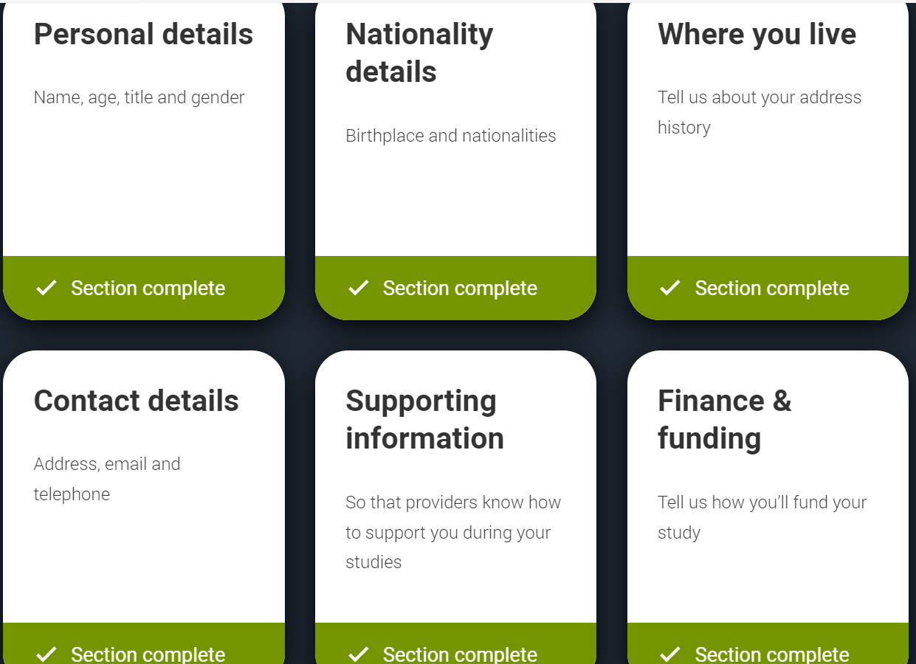
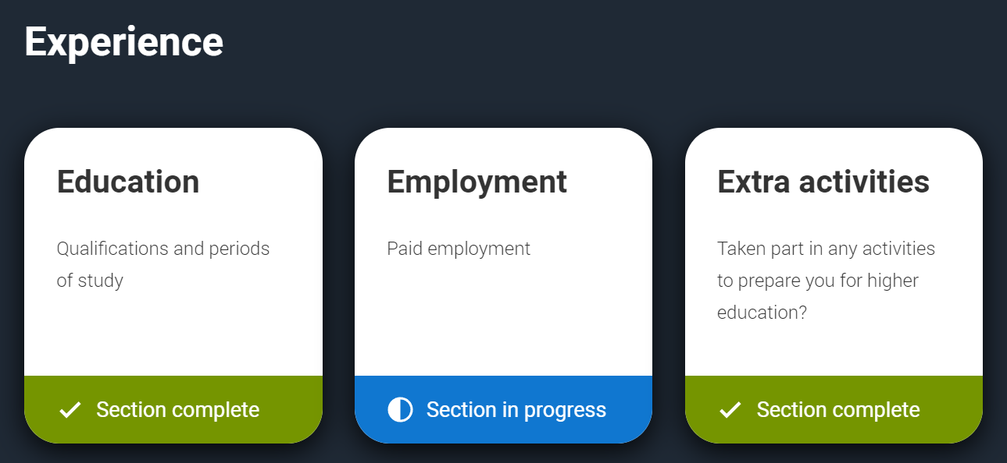
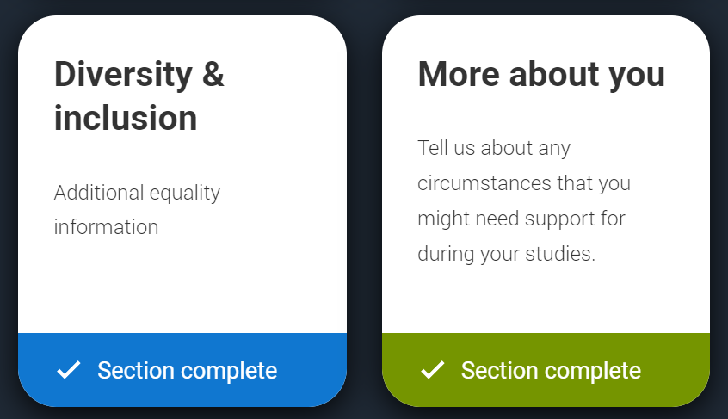
Your profile:
You will need to fill in various sections before your application us complete.
You can change some personal details (like address) later on, but it is better to have them correct at the start.
*Universities will not be aware of info about you unless it is added to your application.

Slide 10
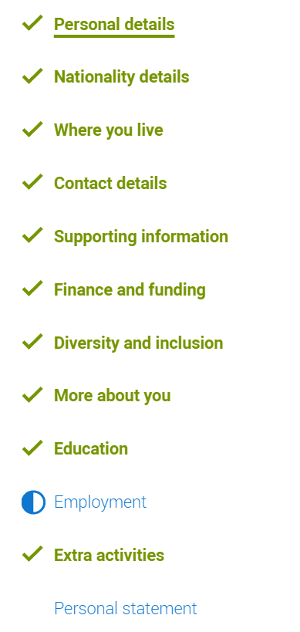
Sections
Once you enter your application you will see the menu
All sections in the end will need to be marked as complete and saved
Save as you go – gradually you will get all the green ticks
We will start it now but you will likely finish it at home with the helpsheet.

Slide 11
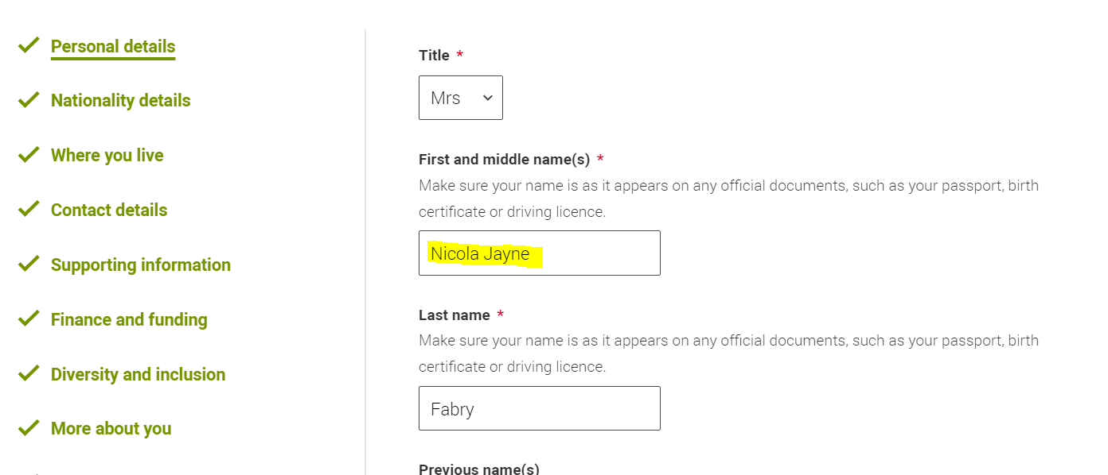
Common Errors – full name
In the Personal Details section enter your full name including your middle name – as it appears on your Passport.
SAVE

Slide 12
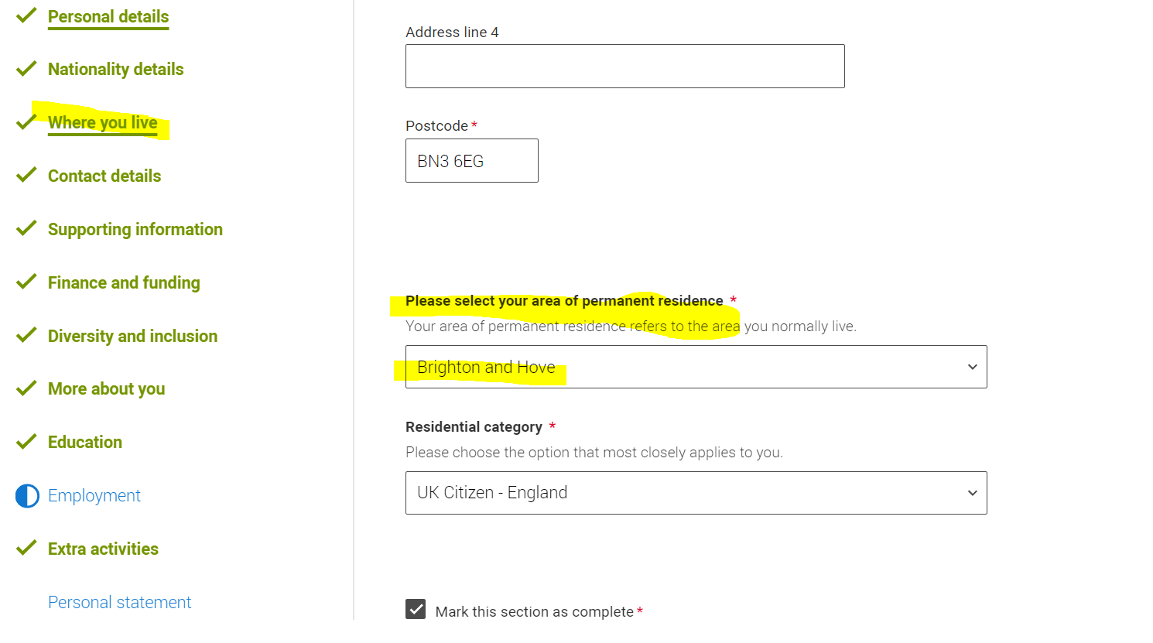
Where you live – Permanent Residence
In the Where you Live section
Add your correct area of permanent residence
This will be Brighton & Hove (including West Saltdean and Portslade
OR West Sussex Southwick to the West
OR East Sussex East Saltdean to the East
SAVE

Slide 13
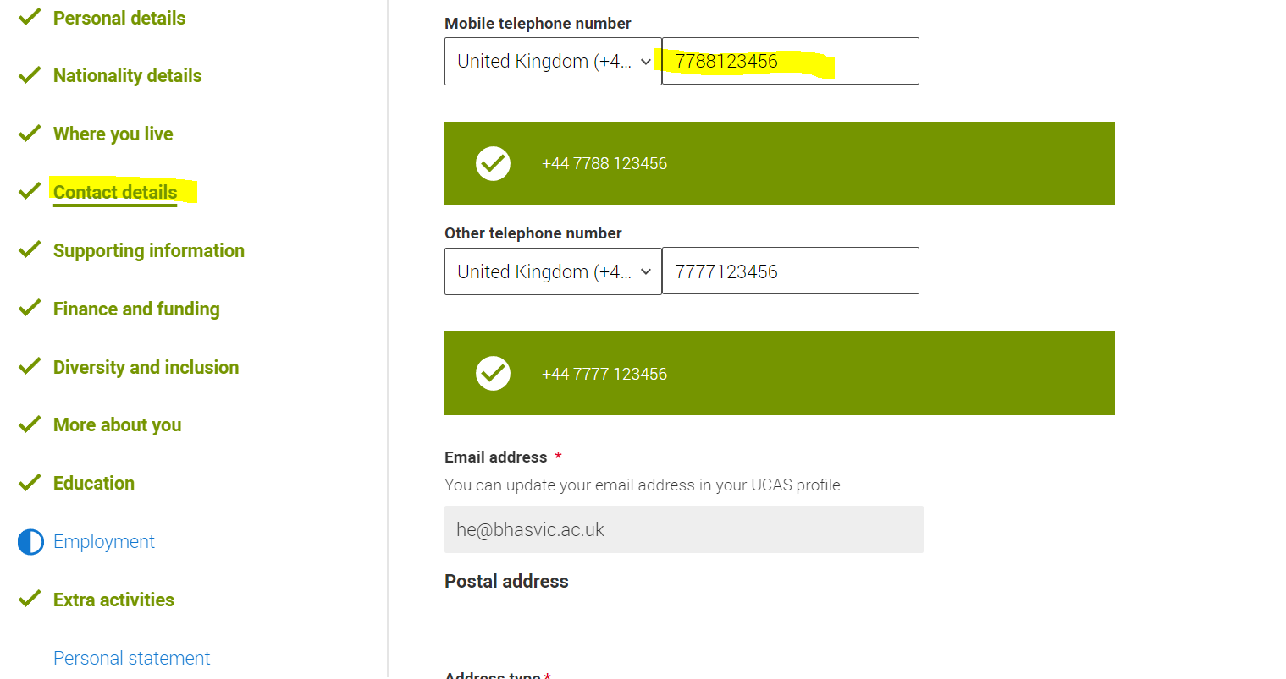
Contact Details – mobile phone
Your email address should come up as the one you are registered with (NOT BHASVIC)
Check you have added your correct mobile number
SAVE

Slide 14
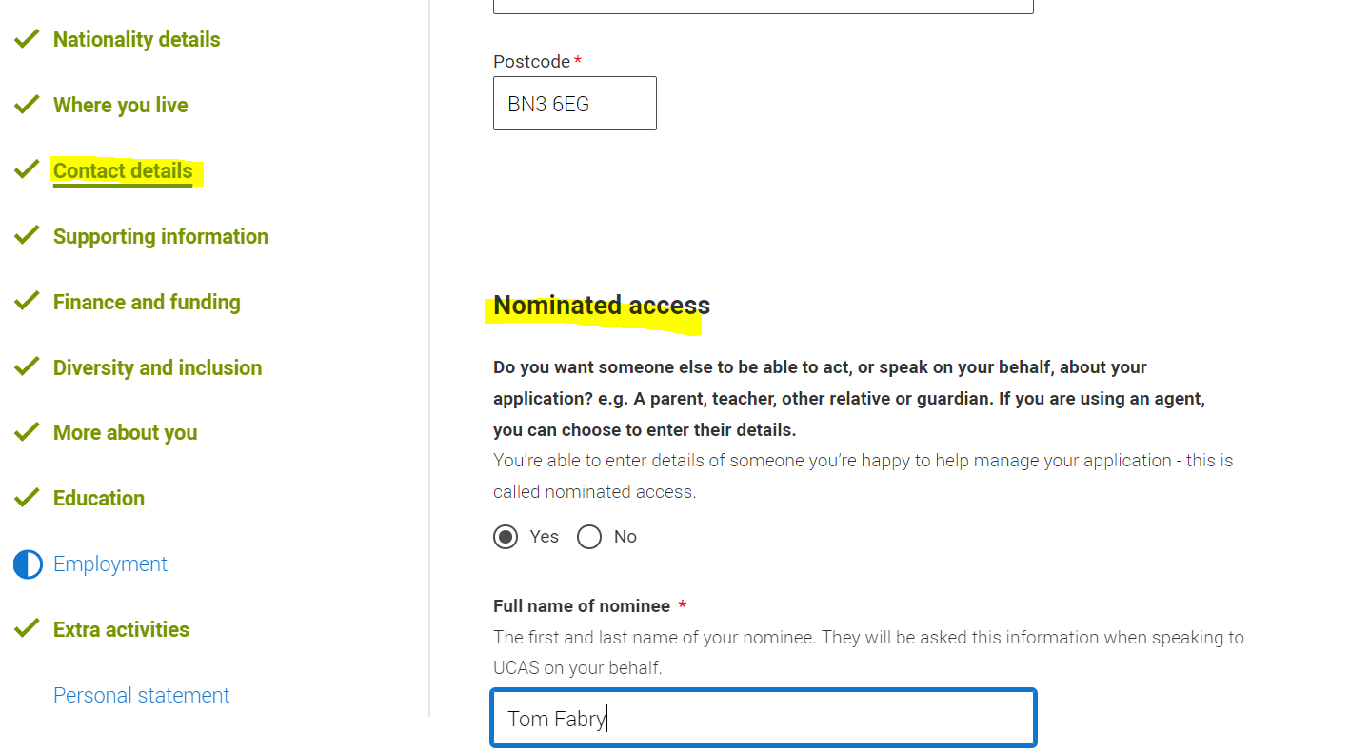
Contact Details – Nominated Access
You can add a sensible adult to contact unis / UCAS on your behalf (useful if travelling on results day).
Saying NO means only you can contact unis.
A nominated access person is useful – even if you never use it
SAVE

Slide 15
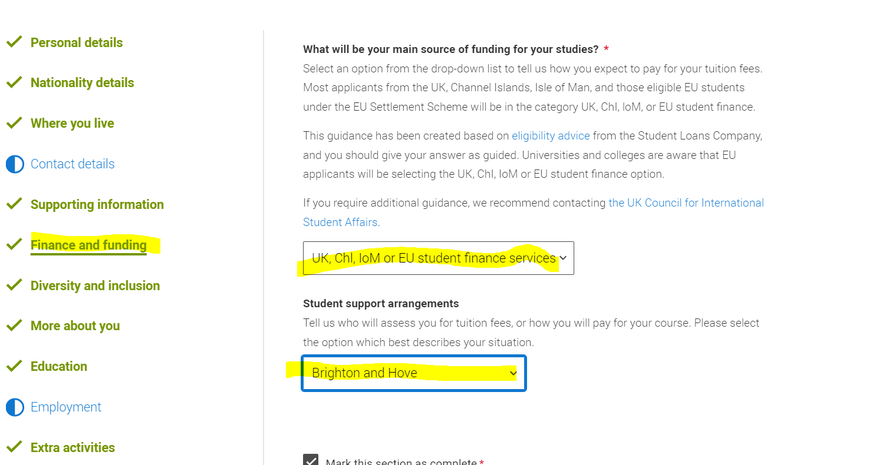
Finance & Funding – Source of Funding
This is REALLY important to get right (it is where your student finance comes from).
Always the second option UK, Chl or EU student finance services (not any other option).
And Brighton & Hove, East or West Sussex. Wherever you live and people at home pay council tax.
SAVE

Slide 16
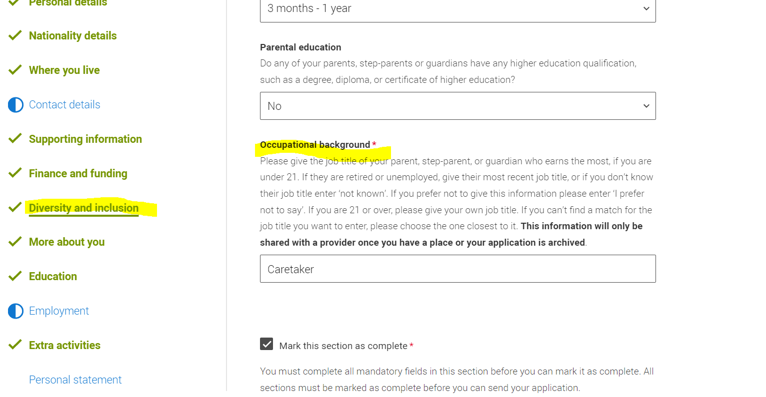
Diversity & Inclusion– Parental Education/Occupational Background
You do need to complete this section although you can choose to prefer not to say. It is helpful for unis to know who their students are though!
Parental background is very important – if the parent you live with has no university degree say no.
Also try and put your occupational background if you can.
SAVE

Slide 17
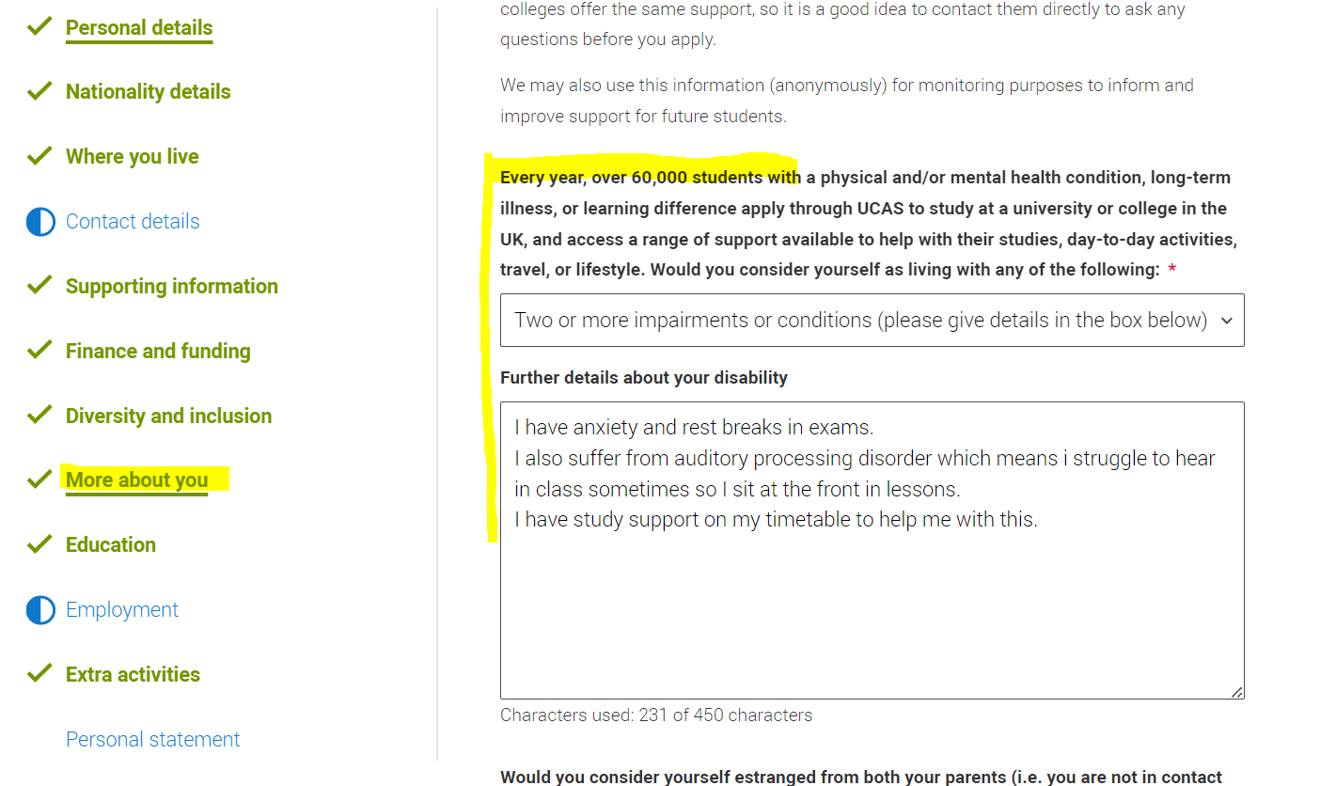
More About You Health
Use this section to disclose any physical or mental health impairments or learning difficulties.
It is very important that unis support you.
Add in the free text Extra Time %, Study Support on your timetable and anything else unis need to know to make your studies successful. This info will also go on your reference.
SAVE

Slide 18
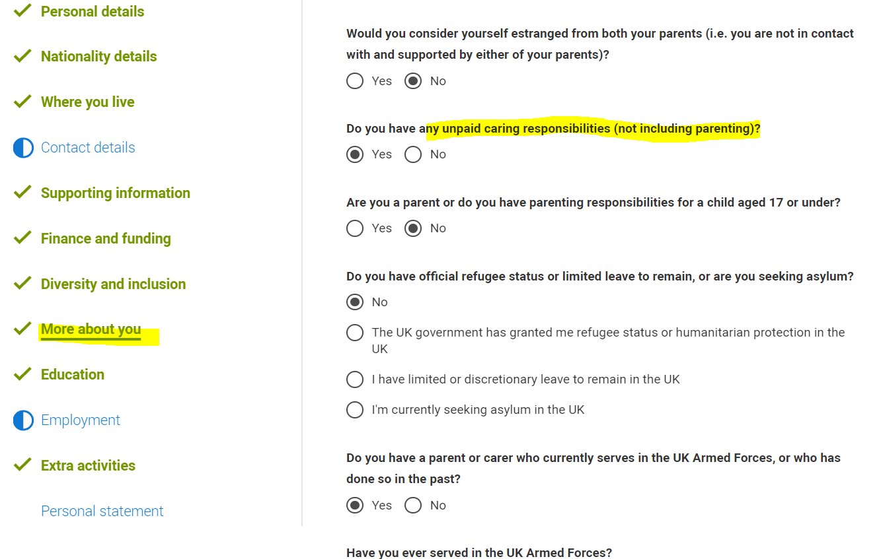
More About You Caring Responsibilities
Complete the rest of this section.
Caring responsibilities – you are a Young Carer if you have someone in your household that has a mental, physical health condition or an addiction.
SAVE

Slide 19
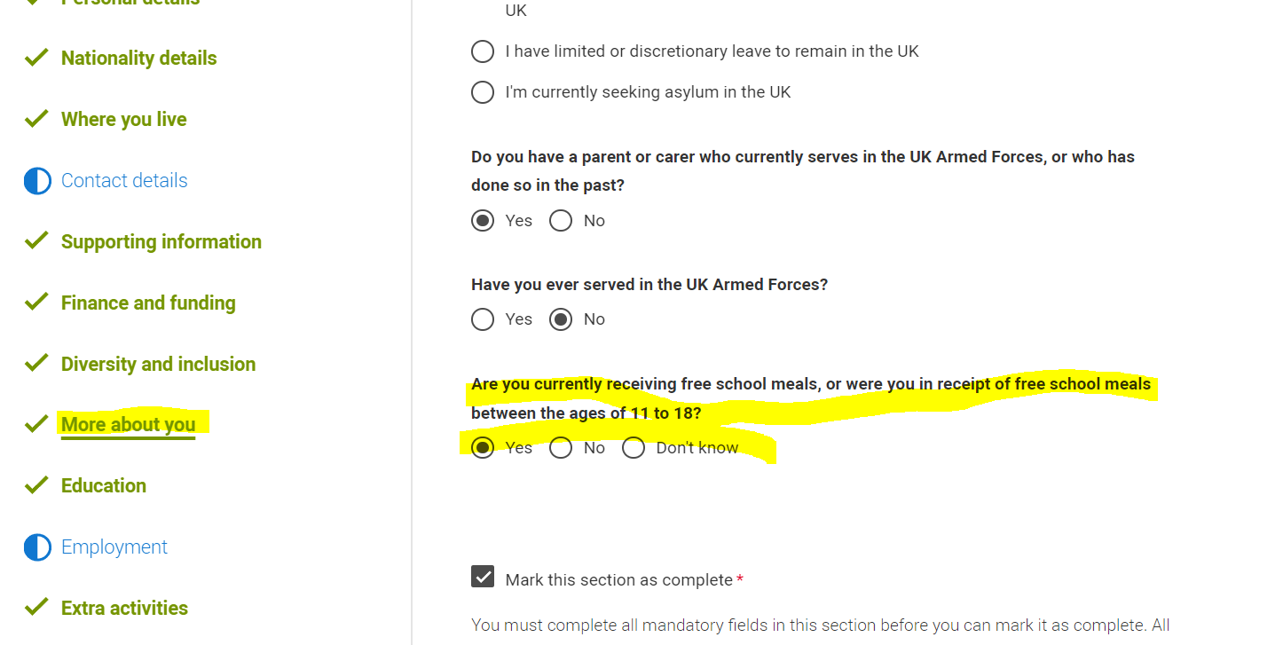
More About You – Free School Meals/Free College Meals
This is very important.
If you have EVER had Free school meals at ANY time in secondary or Free College Meals – vouchers or otherwise, please say YES.
You will get your UCAS application for free this year (saving £28.50).
SAVE

Slide 20
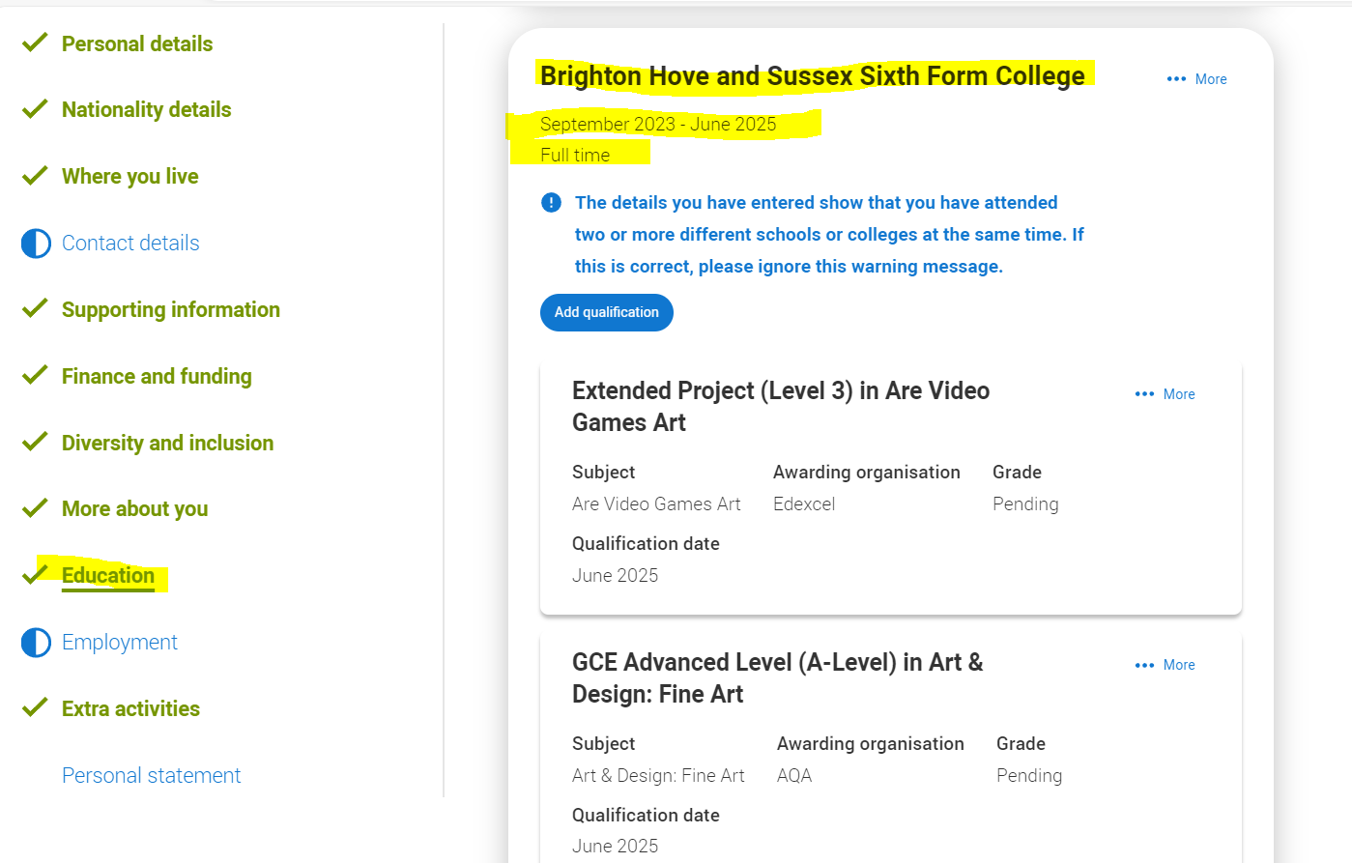
Education section
This is the most complex section which is really important to get right.
Any wrong grades or qualifications missed means you may well not get offers.
It is too tricky to explain on slides – start it but use the helpsheet to double check you have got it right.
Add BHASVIC as a place of education.
SAVE

Slide 21
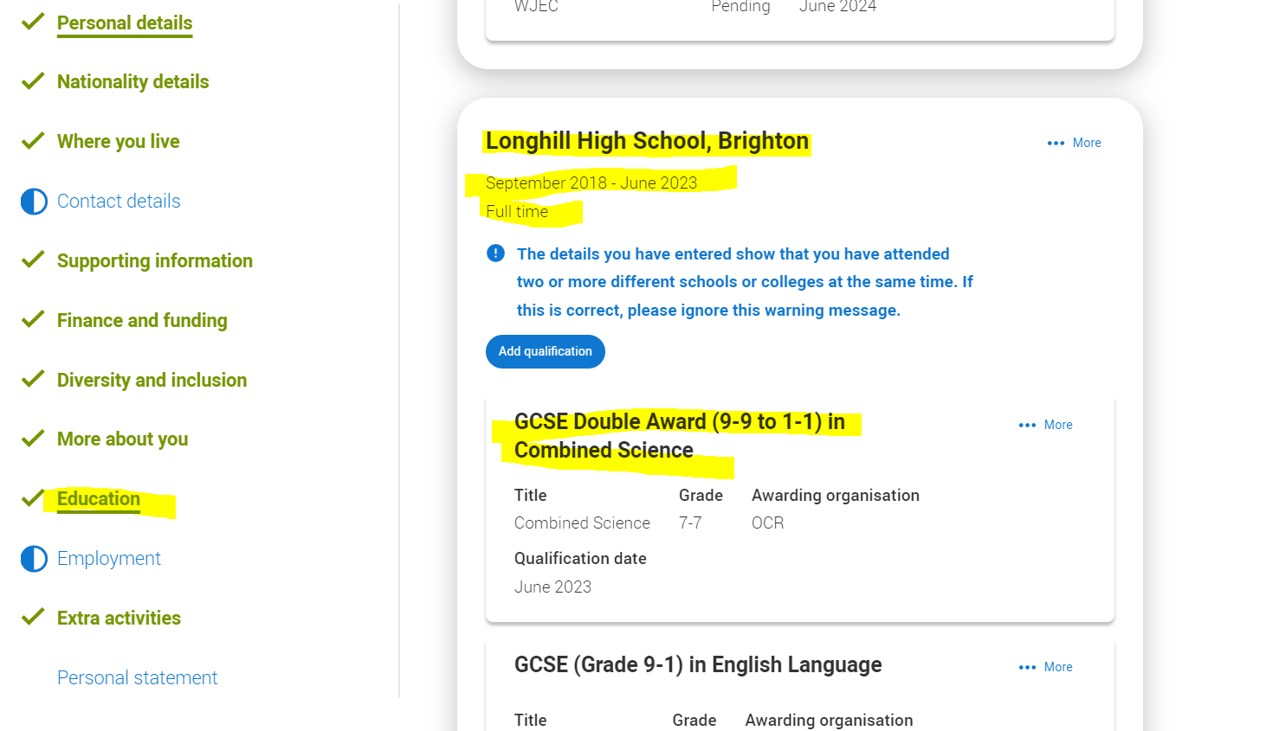
Education section
Add your secondary school and if you have studied Combined Science choose Add qualification Double Award.
It is a tricky one and easy to get wrong.
SAVE

Slide 22
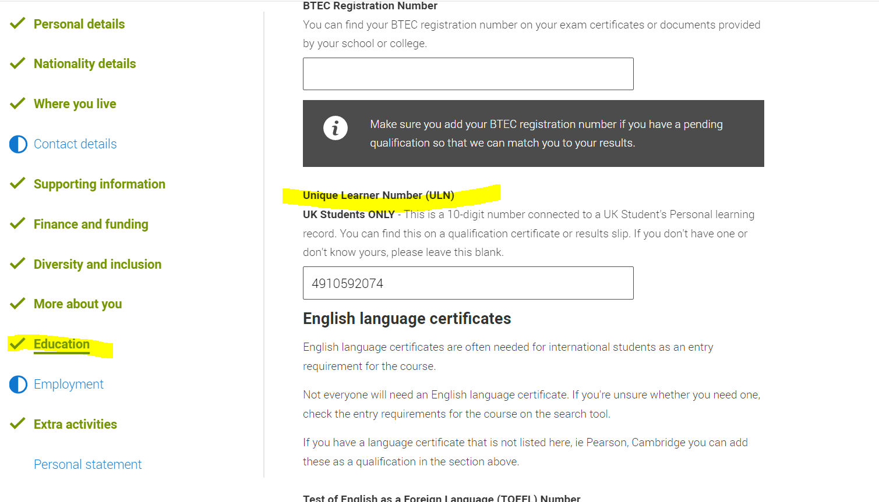
Education section - ULN
On the Education page add your ULN (Unique Leaner Number).
You can copy and paste it from your CEDAR personal details.
This is important as it is how unis link to your results on results day.
SAVE

Slide 23
Checking your application
Early Apps (Oxbridge & Medics) - will be checked early in the summer break (no need for a choice or PS that will be added early September)
UCAS – You will complete the rest of your application at home and attend an Apply session so we go through an early check.
It will then be checked by a Guidance Manager when all completed and General Office will also check before it goes to UCAS.
*It is your responsibility to add qualifications and check grades are correct. Also to add all relevant details*.

