Slide 1
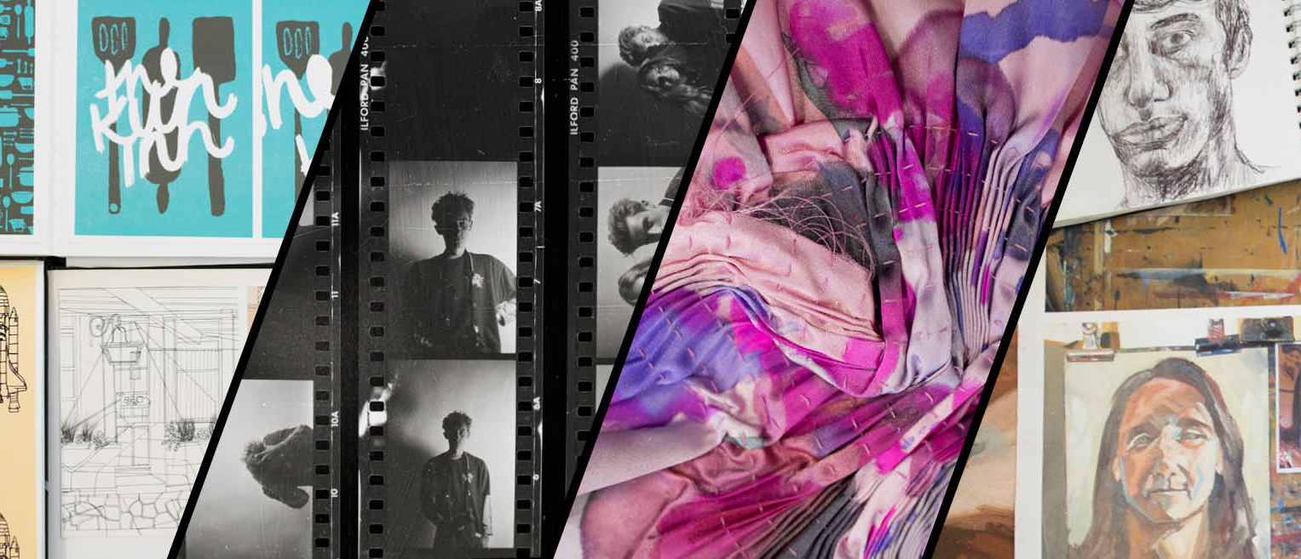
VISUAL ARTS Specialist Evening VA Futures Coordinator- Petrova Clark
GRAPHICS
PHOTOGRAPHY
TEXTILES
FINE ART

Slide 2
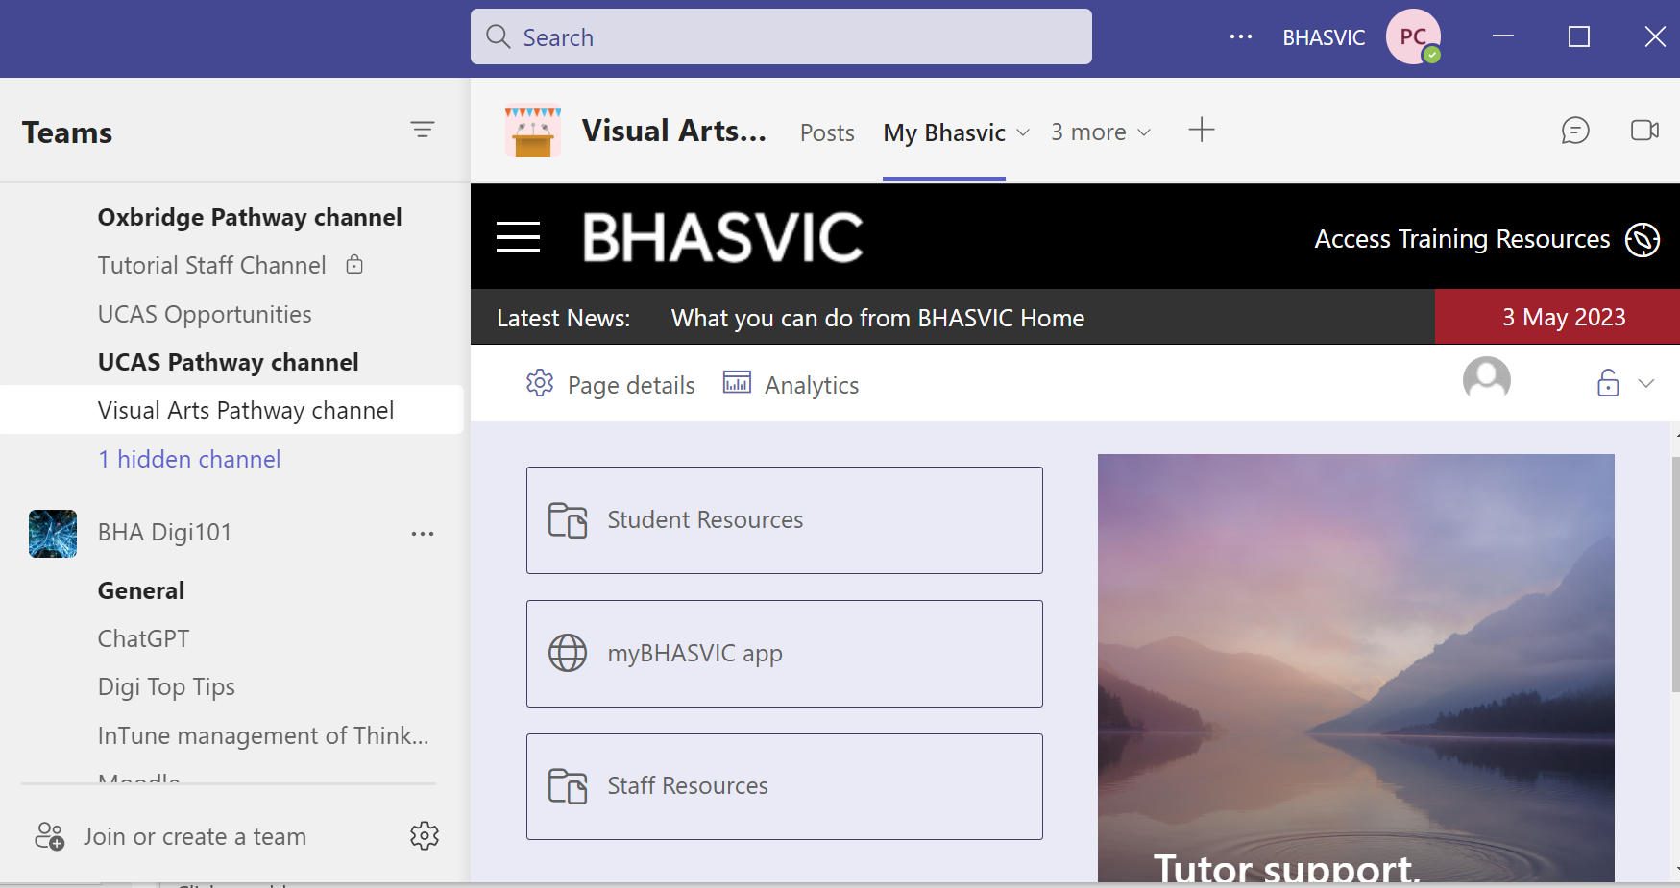
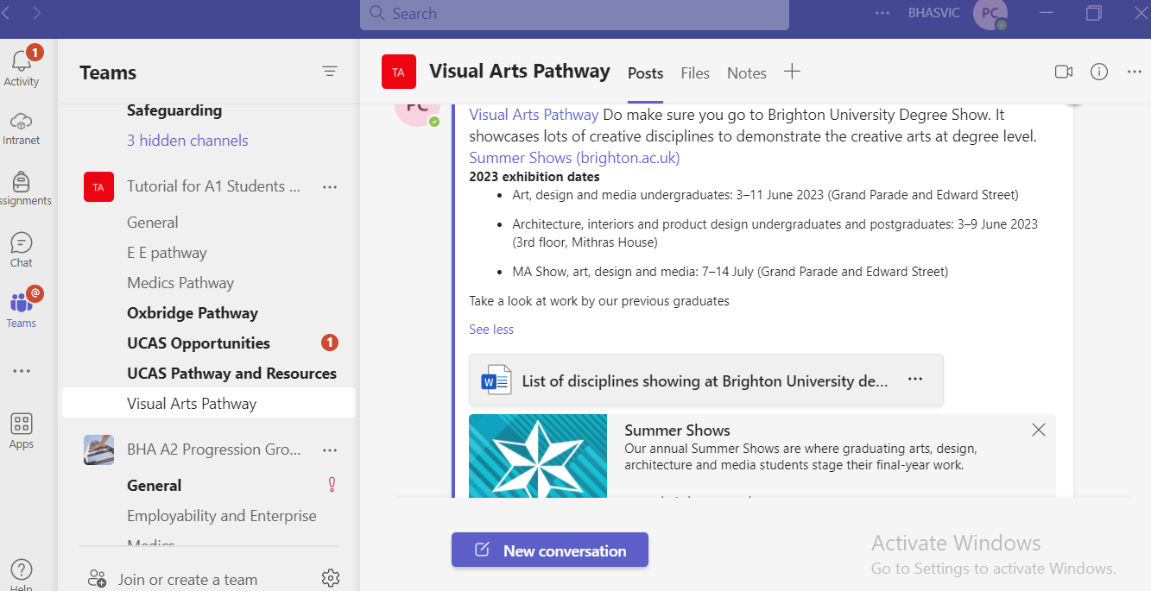
Visual Arts Tutorial Pathway
Students wanting to apply for Visual Arts Courses should opt for this pathway in their A1-A2 Transfer
Weekly Tutorial is structured to support Visual Arts Applications and Future Careers in the Creative Industries. We are happy to support Film/Media and architecture students for creative input into show reels/PS/portfolios.
STJHSDLKJFHLASKJDHFLKJSHDFLKJSDHFLKJSHDFLKJSHDLKJSDHLKSDJHLDSFJKK
VA SharePoint
VA TEAMS

Slide 3
Visual Arts Tutorial Pathway
Creative Industry
The creative Industries are made up of; Advertising, Architecture, Arts & Culture, Crafts, Design, Fashion, Games, Music, Publishing, TV &Film
Headline Statistics about the Creative Industries
Prior to Covid the Creative Industries contributed £116bn in GVA in 2019, growing twice as fast between 2011 and 2019 than the rate of the UK economy as a whole (DCMS 2021).
In the year from July 2020 to June 2021 the Creative Industries accounted for 2.3 million jobs (DCMS 2022).
Self-employment accounts for 32% of Creative Industry employment in the UK compared with 16% for the economy more broadly (DCMS 2021).
In 2019 95% of creative companies were micro-businesses (fewer than 10 employees) which is 6 percentage points more than in the rest of the economy. (DCMS 2022).
Around 300,000, or over one in eight UK businesses (11.8%) in 2019 are part of the Creative Industries (DCMS 2022).
Of all creative businesses, 34% are located in London, 62% in London and the greater South East (London, South East and East of England), 13% in the North of England (North East, North West, and Yorkshire and the Humber), 10% in the Midlands (East and West Midlands), 2% in Wales, 5% in Scotland and 1% in Northern Ireland (ibid.).

Slide 4
Scheme of Work Term 1
FE/HE Options and Research
Artists’ Statements/Personal Statements
Application forms
References
Prep for Physical & Digital Portfolios
One to one Portfolio Reviews
Speakers – working in the local Creative Industries

Slide 5
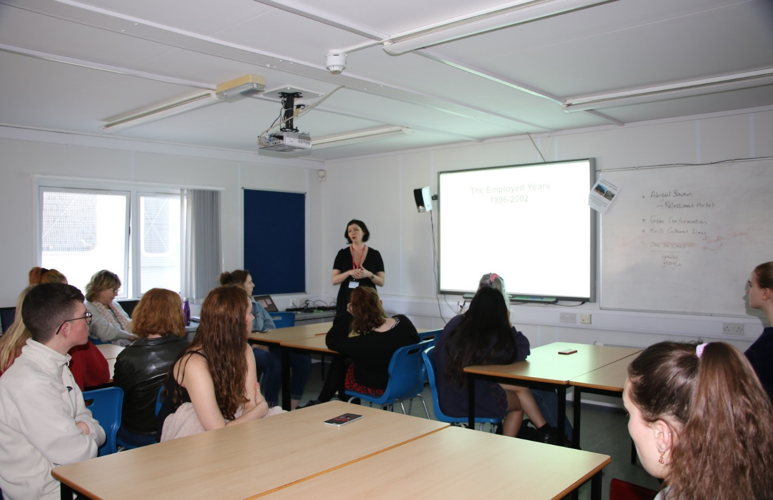
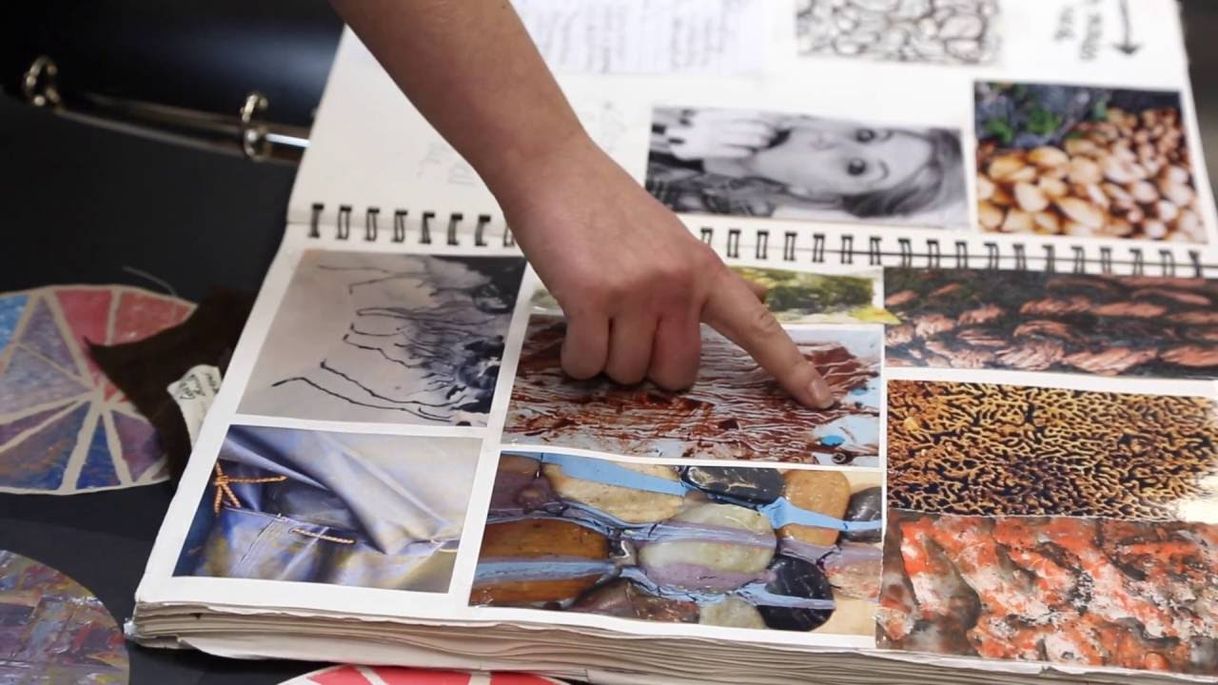
Term 2/3
Prep for face to face Interviews
Independent Living: Student Accommodation, Student Finance, Open Days, Bank Accounts and Budgeting, Payslips
Professionalism: Working in the Creative Industries, Careers, Alumni Speakers, professional footprint/visual output, Creative CV writing.

Slide 6
Finances
There are no fees for Art Foundation Courses if your son/daughter is under 19 when starting the course.
Local councils assume students will be living at home so there is very limited funds available for expenses (such as travel). Most students have part time work with which to support their studies within the confines of their full time course.
Students are expected to buy their own materials (paper, paint, film etc).
Fees are charged for University Degree courses (up to £9k+ per year). Foundation courses may charge a ‘studio fee’ to cover some basic provision of materials/processes etc.

Slide 7
Visual Arts Portfolio Courses
Our portfolio courses are designed to offer students an additional opportunity to build and develop their practice and build on their portfolio. List might change depending on uptake and depend on timetable.
Non VA students who wish to apply in the arts should also do a VA portfolio course.
 | Fine Art | Textiles | Photography | Graphics
Life Drawing | ✓ | ✓
Drawing for Textiles |  | ✓
Graphic Communication |  |  |  | ✓
Photography for Photographers |  |  | ✓
Photography for Beginners | ✓ |  |  | ✓
Digital Art | ✓ | ✓ | ✓ | ✓

Slide 8
University and MET Open Days/Degree Shows
Start visiting University Open Days summer & autumn 2023.
HE Applications on Foundation courses come very quickly and within the first term of the A2 course so get informed about choices in good time.
Check University/Colleges websites for dates of this years degree shows.
Open days are very positive & affirming for students and parents which also help to build confidence and aspiration.
Collect literature, advice and guidance that you can refer to during the A2 year.

Slide 9
Brighton University Degree Shows
Brighton degree show dates announced for 2023 | School of Architecture, Technology and Engineering
When are the shows?
Show: Art, design and media undergraduates Dates: 3rd – 11th June 2023 Location: Grand Parade and Edward Street buildings on our City campus – see maps.
Show: Architecture, interiors and product design undergraduates and postgraduates Dates: 3rd – 9th June 2023 Location: 3rd floor, Mithras House buildings on our Moulsecoomb campus – see maps.
Show: MA art and design graduates Dates: 7th – 14th July 2023 Location: Grand Parade and Edward Street buildings on our City campus – see maps.

Slide 10
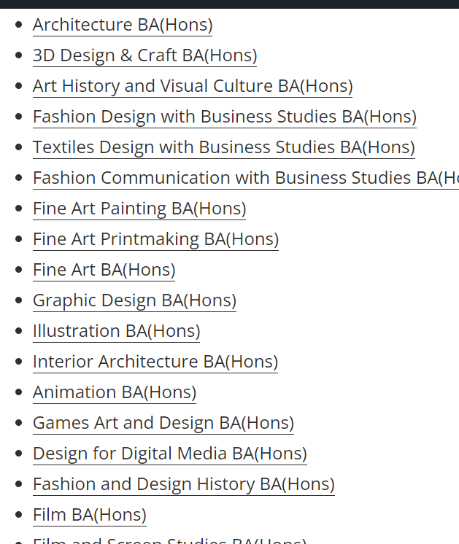
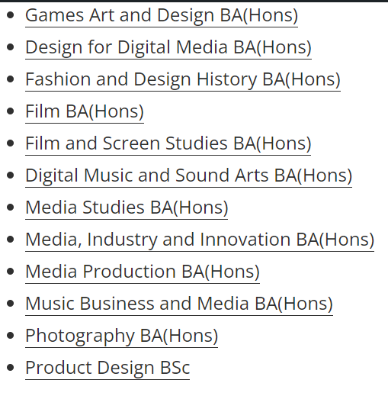
Disciplines for Brighton Uni degree show
Also recommended is ; UAL Graduate Showcase | UAL (arts.ac.uk)

Slide 11
Thank you for joining us for the Visual Arts Tutorial Specialist Pathway Evening
During Progression Week we will be looking at the timeline of all aspects of the Visual Arts Tutorial pathway so students know what to expect and are reassured they will be supported through their application.
We are delighted that your young person has made the decision to explore the creative progression route. We endeavour to deliver up-to-date, relevant and effective support for this transition to FE/HE creative pathways.
Any further questions can be emailed to; p.clark@bhasvic.ac.uk

